Slide 1

Predicting Startup exits
Farooq Qaiser
21-02-2017

Slide 2
Only 25% of venture-backed startups succeed
Notes:
In other words, Venture Capital has a success rate of only 25%, which is apparently one of the more conservative estimates out there.
1. 75% - The Venture Capital Secret: 3 Out of 4 Start-Ups Fail 2. 90% - Why 90% of Startups Fail [INFOGRAPHIC] 3. 90% - DEAR ENTREPRENEURS: Here's How Bad Your Odds Of Success Are 4. 80% - Five Reasons 8 Out Of 10 Businesses Fail 5. 90% - Startup Genome Report

Slide 3
Objective
The aim of this project is to show that machine learning techniques can be used to predict whether a startup will eventually achieve a positive exit outcome or a negative exit outcome.
More simply …
Show that Venture Capital investors can be replaced by computers.

Slide 4




What is an exit? From Venture Capital’s perspective
Positive
Acquisition
IPO
Negative
Operating
Closure
Whatsapp
Dyson
Facebook
Fab
Notes:
Ultimately, every startup journey ends in some kind of an exit.
Broadly speaking, these can be either IPOs, acquisitions or closures.
Of course, a venture can also continue operating without doing any of the above but from a VC’s perspective, this too is a negative outcome as dividends come too slow for the investment vehicle to prove its success to investors.
Some examples of notable exits include:
Whatsapp, bought by Facebook for $19.6 billion
Facebook, which achieved what was back then the biggest IPO ever
Pets.com, one of a number of failed startups from the dotcom era

Slide 5
Who would be interested?
Venture Capital
Maximize return on assets through better identification of high potential startups
Notes:
Investors too are also likely to be interested in the same information given that venture capital as an asset class has historically generated poor returns. For them, the real value would stem from being able to identify accurately (and early on) startups that show signs of making it big.

Slide 6
Who would be interested?
Founders
Understand exit options
Notes:
An exit is one of the important aspects of corporate strategy for almost any startup founder as they offer the chance to cash in years of hard work in the form of their equity holdings.
Understanding the underlying factors that affect exit outcomes is also useful information for guiding entrepreneurs along their journey.

Slide 7

Who would be interested?
Support
Organizations
Maximize return on effort through identification of high potential startups
Notes:
Support organizations with limited funding often need to make difficult decisions around which startups they choose to help and which they don’t.
This topic is also likely to be of interest to the wider population at large.
In recent years, big exits that have turned hundreds of early employees of a few startups into overnight millionaires.

Slide 8
The problems Limited data & Predicting startup success/failure is difficult
Previous research in this area has had limited to work with
Predicting startup success/failure is difficult, even for clever humans!
Notes:
Startups can fail for a great variety of reasons:
Ahead of their time/Market not ready
Bad founders
Founders lack connections to scale
Technology failure
Etc.

Slide 9
The solution CrunchBase + Machine Learning
CrunchBase + Machine Learning
Specifically, we try to predict whether a company will eventually classify as a positive exit outcome or a negative exit outcome, given its results after 3 years.
Notes:
Luckily, today we have access to a vast body of information on startups in the form of CrunchBase, the Wikipedia of the tech world. There is a strong possibility that this information can be mined for predicting startup success/failure.
To explore the value of this information, we will attempt to explore a few demographic, managerial and financial variables within a machine learning framework.

Slide 10
Data wrangling

Slide 11
Data wrangling SQL To Pandas Data frames
MySQL
CSV
Python
Pandas
Notes:
CrunchBase provides a snapshot of their database from the end of 2012.
Overall easy as fairly structured and clean data is provided
Load sql files into a noSQL database (difficult as there were errors in scripts)
Export data as csv files
Read in to python
Extract information that has timestamp data associated with it
Join all data together (different data comes from different csv files)
Keep only first 3 years of data for each startup

Slide 12
Data wrangling Pandas to features
Objects
Founding Date
Sector
Country
Milestones
# Milestones
Investments
Top VC Backed
City
Relationships
# Board
# Employees
Funding Rounds
# Founders
# Funding Events
$ Total Raised to Date
$ Last Raised
Notes:
Using data from companies founded between 2000 and 2009 (inclusive).

Slide 13
Dataset 43,298 samples and Plenty of missing data
ID | Status | Founding Date | Country | City | Sector | # Board | # Employees | # Founders | # Milestones | # Funding Events | $ Total Raised to Date | $ Last Raised | Top VC Backed | TC Articles | Previously Founded
Notes:
As is to be expected with any public dataset, there is lots of missing data.
It is likely though that some of this data was only missing at the time. Remember, we’re looking only at the data available on each startup when it was 3 years old or less.
Missing data is only a “problem” here because the machine learning techniques I apply for this project are not capable of handling missing data intrinsically.
So, how should I deal with missing data?
Simply removing samples with missing data isn’t a viable option since this dramatically reduces the number of samples and the performance of the machine learning techniques I use partly depends on the amount of training data I feed them.
Instead, I make some simplifying assumptions where data is missing.
I believe this assumption is fair since CrunchBase is a fairly popular source for data on startups, similar to how LinkedIn is the first source of information people will turn to for information on professional contacts. For this reason, I assume that there is sufficient incentive to motivate founders to fill in data where available and keep that data up to date. So for example, if a company did not report any funding, we will assume that this company raised $0.
0 where missing with the exception of Founders where we assumed 1 if missing.

Slide 14
Potential Future Improvements
Use CrunchBase API to fill in data that was previously missing
Use CrunchBase API to gather data on startups founded after 2009
Interface Pandas directly with MySQL
Use more granular location data through Google APIs

Slide 15
Exploratory data analysis

Slide 16
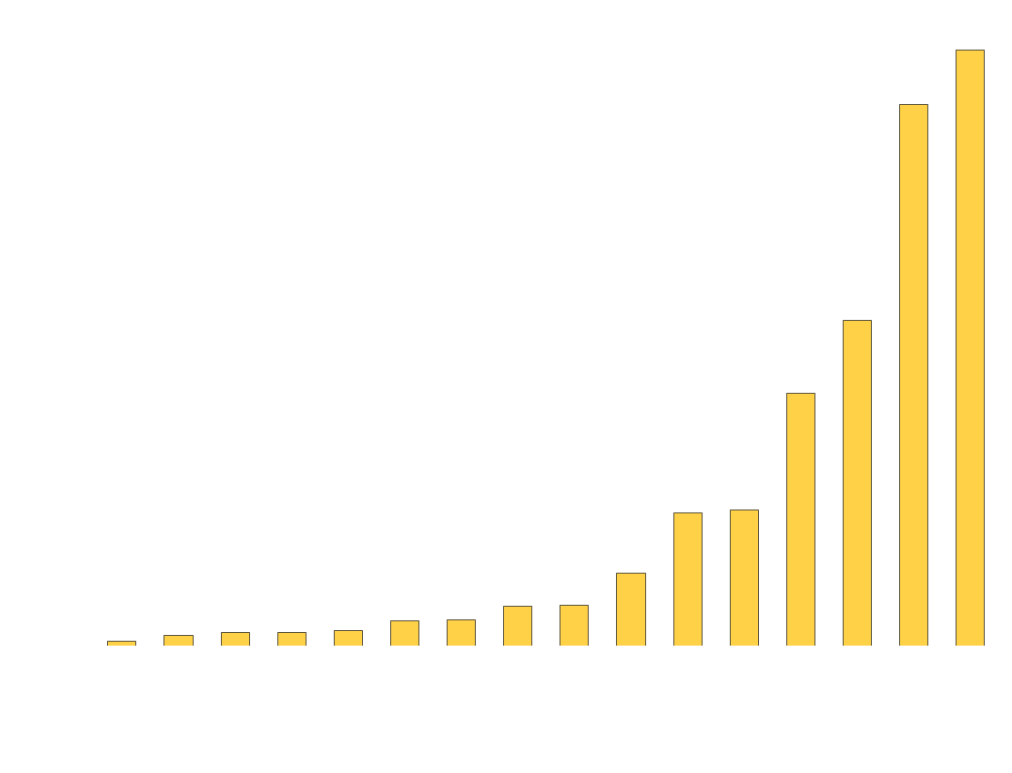
Category distribution Most of sample consists of internet or software related startups
Notes:
Most startups that are founded are either internet or software startups.

Slide 17

Exits by Type
Notes:
Underrepresentation of closed number of firms.
Bias in data collection. Like asking a dead person to let us know they’re dead.
The IPOs and acquisitions numbers are in line with what we expect in the startup ecosystem.
This does however mean that there is a class imbalance problem i.e.
The number of negative samples exceeds the number of positive samples by a huge margin.

Slide 18
Exits by Type underrepresentation of closed startups; biased Data!
Notes:
Underrepresentation of closed number of firms.
Bias in data collection. Like asking a dead person to let us know they’re dead.
The IPOs and acquisitions numbers are in line with what we expect in the startup ecosystem.
This does however mean that there is a class imbalance problem i.e.
The number of negative samples exceeds the number of positive samples by a huge margin.

Slide 19
Exits by Type Significant class imbalance
Negative Exits
Positive Exits
Notes:
Underrepresentation of closed number of firms.
Bias in data collection. Like asking a dead person to let us know they’re dead.
The IPOs and acquisitions numbers are in line with what we expect in the startup ecosystem.
This does however mean that there is a class imbalance problem i.e.
The number of negative samples exceeds the number of positive samples by a huge margin.

Slide 20
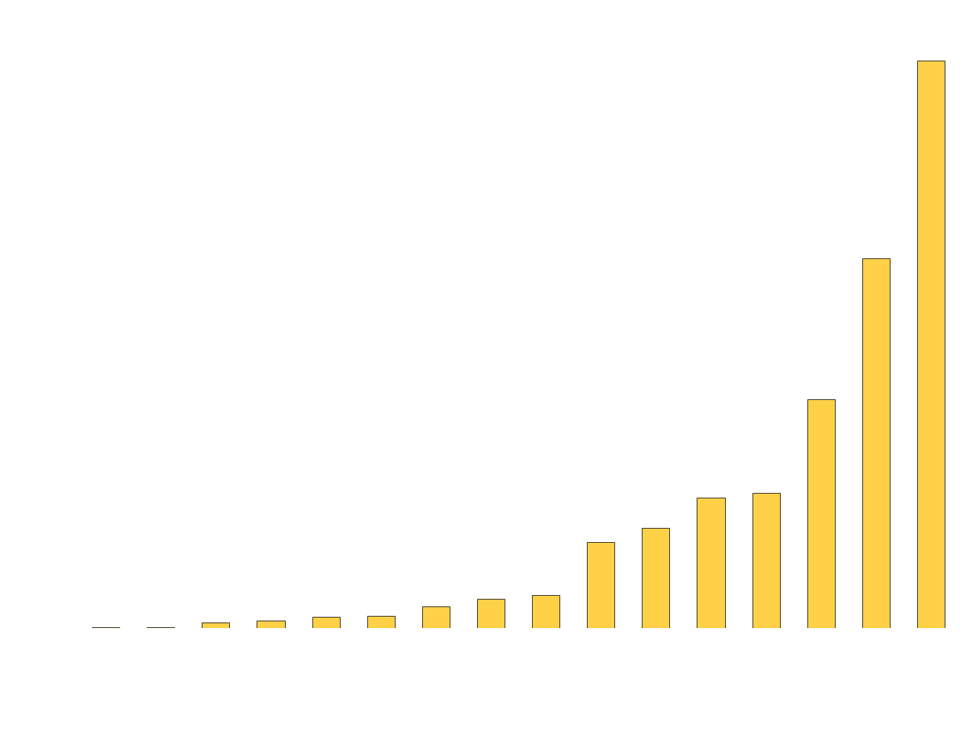
Positive Exits by Category Most of the positive exits are from software and Internet startups
Notes:
Most of the positive exits have come from internet and software startups.
This isn’t too much of a surprise since these are also the 2 largest sectors.

Slide 21

Exits by Category Security startups are the most likely to achieve a positive exit
Notes:
Interestingly, an exit is more likely in security and hardware startups than it is in legal and edtech startups.

Slide 22
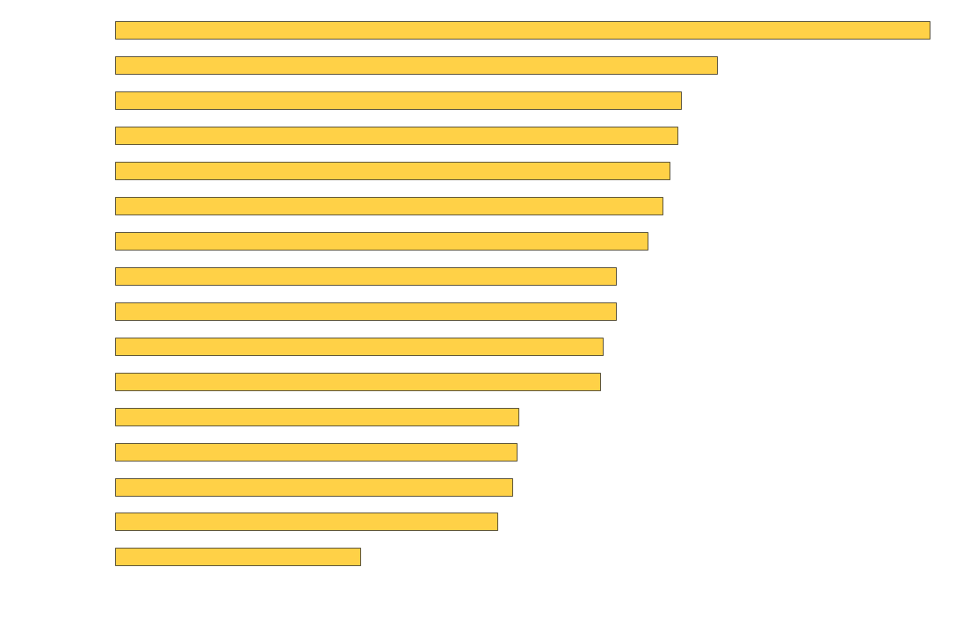
Average months to positive exit Security startups are the most likely to achieve a positive exit
Notes:
We see that firms in software-oriented sectors (e.g. social, analytics, internet, search) are quickly able to achieve a positive exit.
In other, more hardware oriented sectors (e.g. Cleantech), firms take some time to achieve a positive exit.
Fintech and health are highly regulated industries so it makes sense that firms in these sectors on average take longer to achieve a positive exit.

Slide 23
Results after 3 years
Positive
Negative
 | Mean | n | Mean | n
# Employees | 0.38 | 1,670 | 0.36 | 11,225
# Founders | 1.70 | 1,172 | 1.54 | 7,023
# Board | 0.42 | 183 | 0.22 | 1,070
# Milestones | 0.45 | 858 | 0.61 | 4,190
# Funding Events | 0.85 | 1,908 | 0.59 | 11,138
$ Total Raised to Date | $6,787,465 | 1,908 | $2,764,268 | 11,138
$ Last raised | $4,200,506 | 1,908 | $2,024,625 | 11,138
# Top VC Investors | 1.81 | 1,683 | 0.96 | 7,684
# TC Articles | 0.06 | 858 | 0.03 | 4,190
# Previously Founded | 0.75 | 181 | 0.63 | 589
Notes:
Even as early as 3 years on, you can see there are some slight differences between companies that eventually go on to achieve a positive exit and companies that don’t.
The negative exits data is likely to be biased upwards because of the underrepresentation of closed startups we saw earlier.

Slide 24
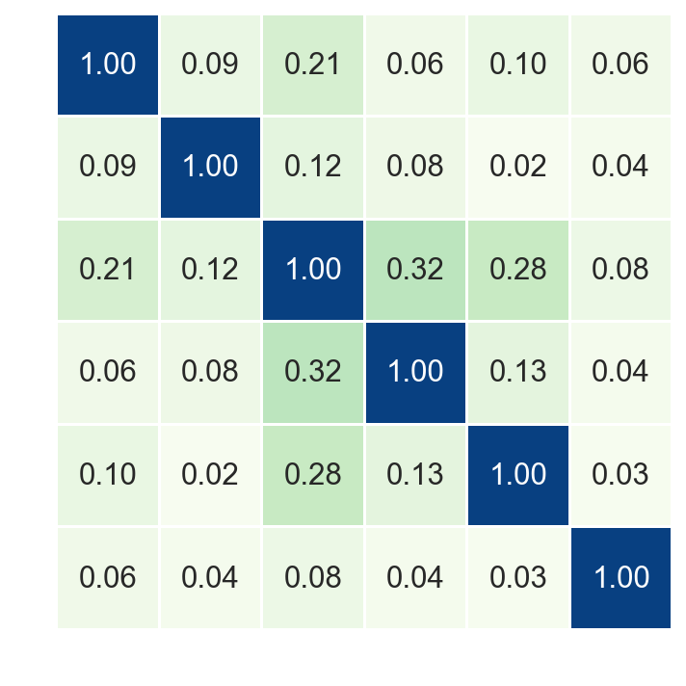
Correlation Between results after 3 years
0 Employees
1 Milestones
2 Funding Events
3 $ Total Raised to Date
4 Top VC Backed
5 Previously Founded
Notes:
While it’s nice to see some of the correlations we expect to see in our data, some data science techniques struggle with correlations so we need to remain mindful of this.

Slide 25
Machine learning

Slide 26
SMOTE Synthetic Minority Over-sampling Technique
SMOTE is an oversampling method and works by creating synthetic samples from the minor class (as opposed to creating copies).
The algorithm selects two or more similar instances (using a distance measure) and perturbs an instance one attribute at a time by a random amount within the difference to the neighboring instances.
Notes:
To learn more about SMOTE, see the original 2002 paper titled “SMOTE: Synthetic Minority Over-sampling Technique“.

Slide 27
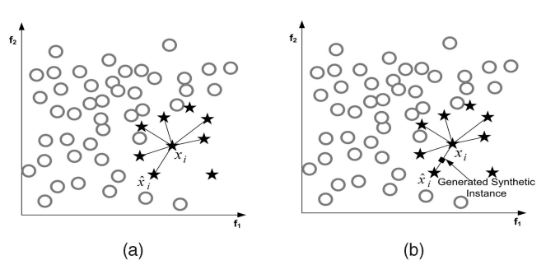
SMOTE Synthetic Minority Over-sampling Technique
Notes:
To learn more about SMOTE, see the original 2002 paper titled “SMOTE: Synthetic Minority Over-sampling Technique“.

Slide 28
Naïve Bayes Base model
Simple probabilistic classifier based on Bayes' theorem:
p(B|A) = p(A|B) p(B) / p(A)
The 'naive' part of the name comes from the strong (ergo naive) independence assumptions between the features.
Despite this, Naive Bayes algorithms have been applied in various domains with surprising success.
We will use this as our base model.

Slide 29
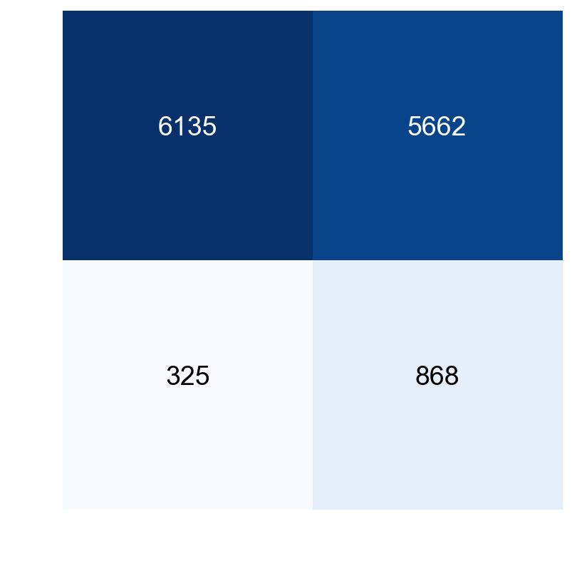
Naïve Bayes Confusion Matrix

Slide 30
Naïve Bayes Confusion Matrix
True Negatives
False Positives
False Negatives
True Positives

Slide 31
Naïve Bayes Confusion Matrix
True Negatives
False Positives
Precision | 0.13
Specificity | 0.52
Recall | 0.73
F1 | 0.22
False Negatives
True Positives

Slide 32
Naïve Bayes Precision
True Negatives
False Positives
This is essentially our success rate!
Precision | 0.13
Specificity | 0.52
Recall | 0.73
F1 | 0.22
False Negatives
True Positives
Notes:
Precision is a measure of how many of the positive predictions from our model are actually true positives.
This is is similar to the VC success rate we mentioned earlier.
So this is really the number we care about and want to be good as possible (i.e. as close to 1 as possible)!
Unfortunately though, our Naive Bayes model does worse than VCs.
Let’s see if we can get better results from a more advanced model.

Slide 33
Naïve Bayes Precision
True Negatives
False Positives
868
=
0.13
868+ 5662
False Negatives
True Positives

Slide 34
Naïve Bayes Recall
True Negatives
False Positives
Precision | 0.13
Specificity | 0.52
Recall | 0.73
F1 | 0.22
False Negatives
True Positives
This is a measure of how many of the true positives we actually identified!
Notes:
Recall is another useful measure of success for us.
It measures how many of the true positive exits our model captured and how many we missed.
The venture capital world is full of stories of investors passing up on what in hindsight were amazing opportunities e.g. XXX passing up on AirBnB the first time round.

Slide 35
Naïve Bayes Recall
True Negatives
False Positives
868
=
0.73
868 + 325
False Negatives
True Positives
Notes:
Recall is calculated as shown above.

Slide 36
Ensemble Model Naïve Bayes, Decision Tree, Random Forests, Gradient Boosting
Training data
Classification
Models
NB
DT
RF
GB
Testing Data
P₁
P₂
P₃
P₄
Predictions
Voting
Final
Prediction
P_{Final}
Notes:
This is an overview of the Ensemble method where we use several classification models.
The principle behind this method is that each model has its own combination of strengths and weaknesses and thus using several models is a better idea.
Intuitively,

Slide 37
Ensemble Model Naïve Bayes, Decision Tree, Random Forests, Gradient Boosting
Training data
Classification
Models
NB
DT
RF
GB
New Data
P₁
P₂
P₃
P₄
Predictions
Voting
Final
Prediction
P_{Final}
Notes:
First we train each of the models individually, performing 5 fold cross validation to select the parameters that give us the highest precision on our training data.
NB = Naïve Bayes
DT = Decision Tree
RF = Random Forests
GB = Gradient Boosting

Slide 38
Ensemble Model Naïve Bayes, Decision Tree, Random Forests, Gradient Boosting
Training data
Classification
Models
NB
DT
RF
GB
Testing Data
P₁
P₂
P₃
P₄
Predictions
Voting
Final
Prediction
P_{Final}
Notes:
Next we pass the testing data to each of the models.

Slide 39
Ensemble Model Naïve Bayes, Decision Tree, Random Forests, Gradient Boosting
Training data
Classification
Models
NB
DT
RF
GB
Testing Data
P₁
P₂
P₃
P₄
Predictions
Voting
Final
Prediction
P_{Final}
Notes:
Each model then makes a prediction for each sample.

Slide 40
Ensemble Model Naïve Bayes, Decision Tree, Random Forests, Gradient Boosting
Training data
Classification
Models
NB
DT
RF
GB
Testing Data
P₁
P₂
P₃
P₄
Predictions
Voting
Final
Prediction
P_{Final}
Notes:
There are several ways to do the final voting.
We went with the simplest case where simple majority vote determines the class of each testing sample.

Slide 41
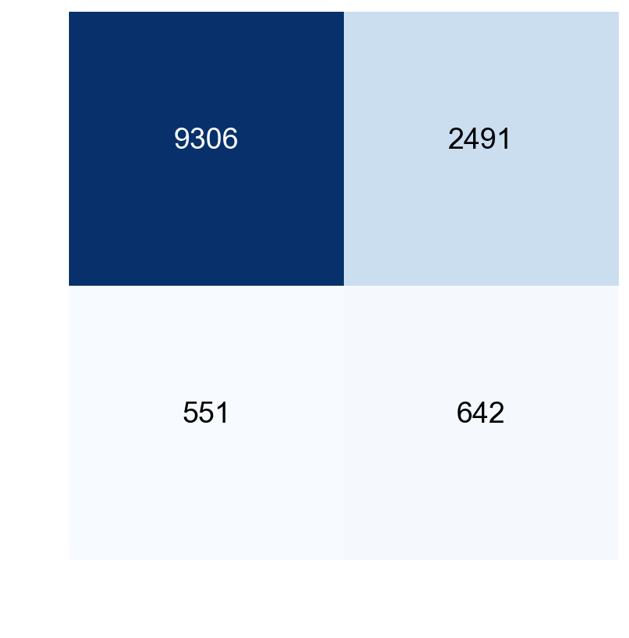
Ensemble Model MNB, Decision Tree, Random Forests, Gradient Boosting
True Negatives
False Positives
Precision | 0.20
Specificity | 0.79
Recall | 0.54
F1 | 0.30
False Negatives
True Positives
Notes:
So we’ve got a

Slide 42
Ensemble Model MNB, Decision Tree, Random Forests, Gradient Boosting
True Negatives
False Positives
Ensemble
NB
Precision | 0.20
Specificity | 0.79
Recall | 0.54
F1 | 0.30
▲
▲
▼
▲
0.13
0.52
0.73
0.22
False Negatives
True Positives
Notes:
So we’ve got a fairly good final model.
We’ve managed to very nearly match the Venture Capital success rate (remember ~25%).
Although our Recall rate has gone down, it’s still fairly impressive and makes up for all of the False Positives too.

Slide 43
Examples of Successful predictions in testing data

Slide 44
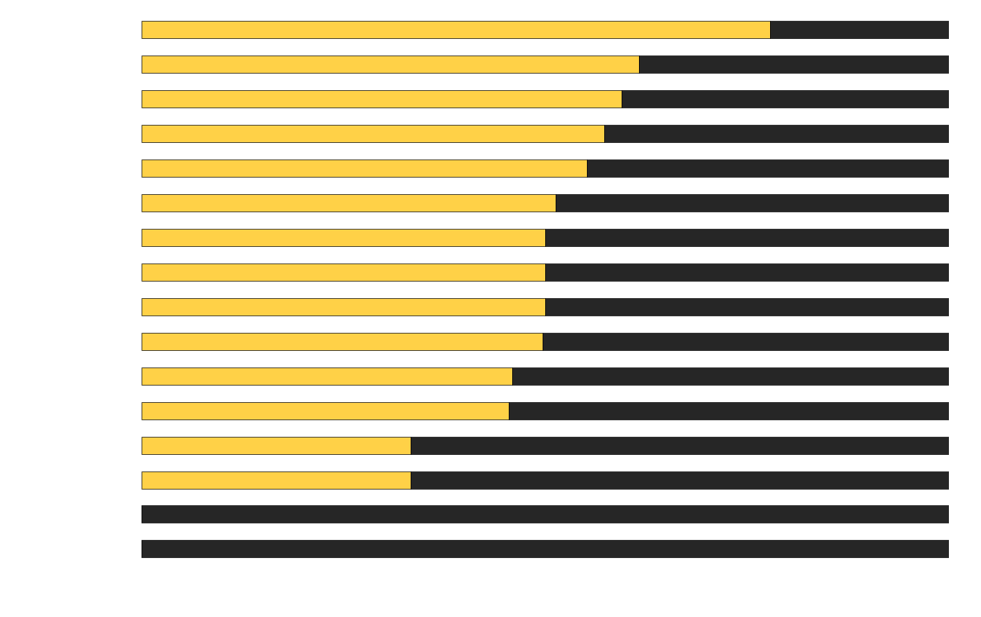
Error Analysis poor job of identifying positive exits across all sectors

Slide 45
Potential Future Improvements
Try topic modelling - value in mining textual data A Supervised Approach to Predict Company Acquisition With Factual and Topic Features Using Profiles and News Articles on TechCrunch
Try Bayesian Networks - can handle missing data natively
Try Penalized models -
Notes:
http://www.cs.cmu.edu/~guangx/papers/icwsm12-long.pdf

Slide 46
Conclusions

Slide 47
Conclusions
The aim of this project was to show that machine learning techniques can be used to predict whether a startup will eventually achieve a positive exit outcome or a negative exit outcome. ✓
Show that Venture Capital investors can be replaced by computers ✗
VC jobs are safe…
(for now)

Slide 48
Recommendations
Use this model as a way to quickly shortlist ventures
Iterate upon model with previously suggested improvements and in particular by collecting more data and exploring the value of a Bayesian Networks in this setting.

